Slide 1
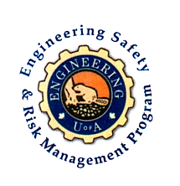
Fundamentals of RM
RM System and Process
Leadership in RM
Incident Investigation
RM Tools & Challenges
RM in Industry
People & Org.
Applications & Perspectives
On Becoming a Leader in Risk Management
ENGG404 - Lecture
Chapter 2.5 What is an Acceptable Level of Risk?
1
Notes:
ENGG404 Lecture 00 - Day 1
1
1

Slide 2
Learning Outcomes:
Interpret a set of risk criteria to determine a risk level.
Construct risk matrices for simple operations and systems, and evaluate the acceptance of risks through these matrices.
Apply a generic risk matrix to decide whether to accept the residual risk and manage it, or determine if additional control measures / safeguards are needed to reduce the risk to an acceptable level.
Chapter 2.5 What is an Acceptable Level of Risk?
2

Slide 3
The Simple Risk Matrix:
Simple Risk Matrix:
H
M
L
M | H | H
L | M | H
L | L | M
Terms Used:
Consequence = Impact =
Severity
Likelihood = Probability = Frequency
Increasing Consequence
L M H
Increasing Likelihood
Chapter 2.5 What is an Acceptable Level of Risk?
Notes:
3

Slide 4
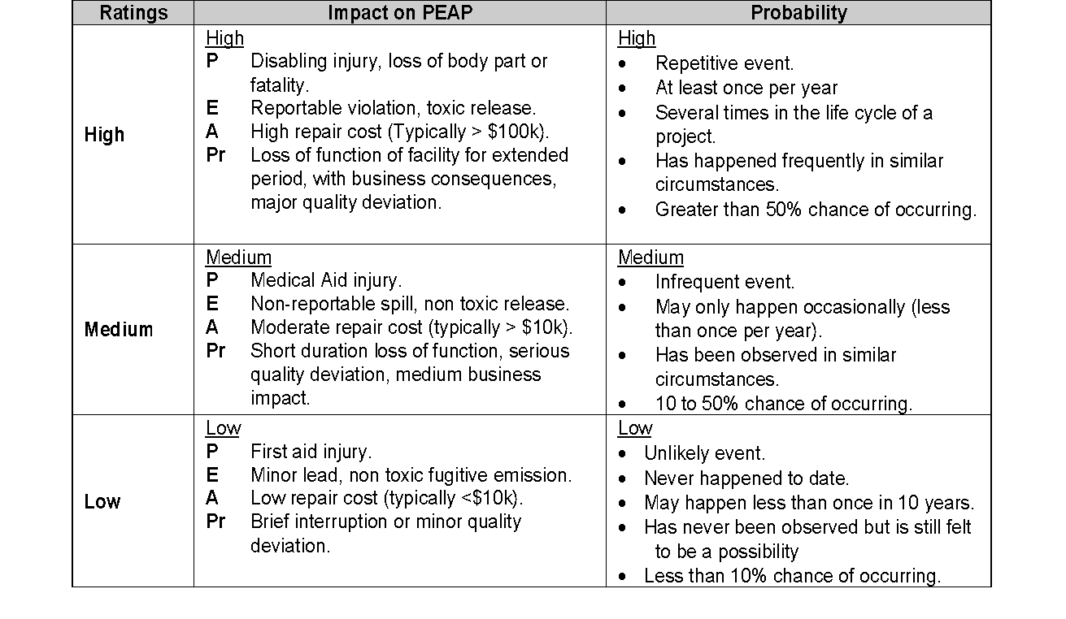
Risk Criteria Table:
L, M, H Consequence and L, M, H Likelihood (This is relative and will change depending on the company.)
Consequence
Likelihood
Chapter 2.5 What is an Acceptable Level of Risk?
4
Notes:
4

Slide 5
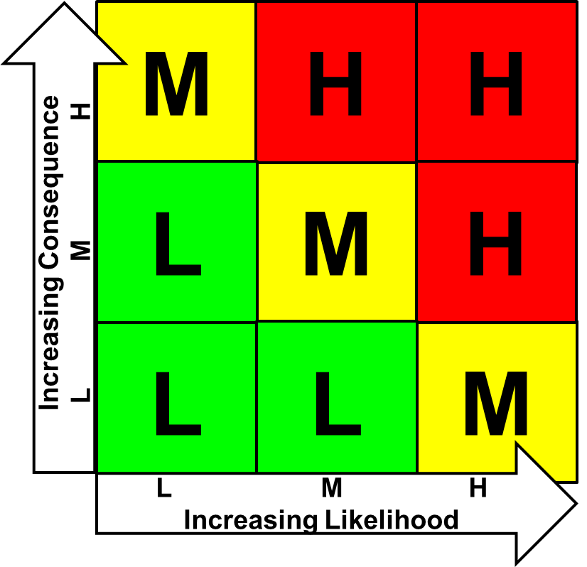
Risk Criteria Table:
L, M, H Consequence
Consequence
Likelihood
Chapter 2.5 What is an Acceptable Level of Risk?
5
Notes:
5

Slide 6
Risk Criteria Table:
L, M, H Likelihood
Consequence
Likelihood
Chapter 2.5 What is an Acceptable Level of Risk?
6
Notes:
6

Slide 7
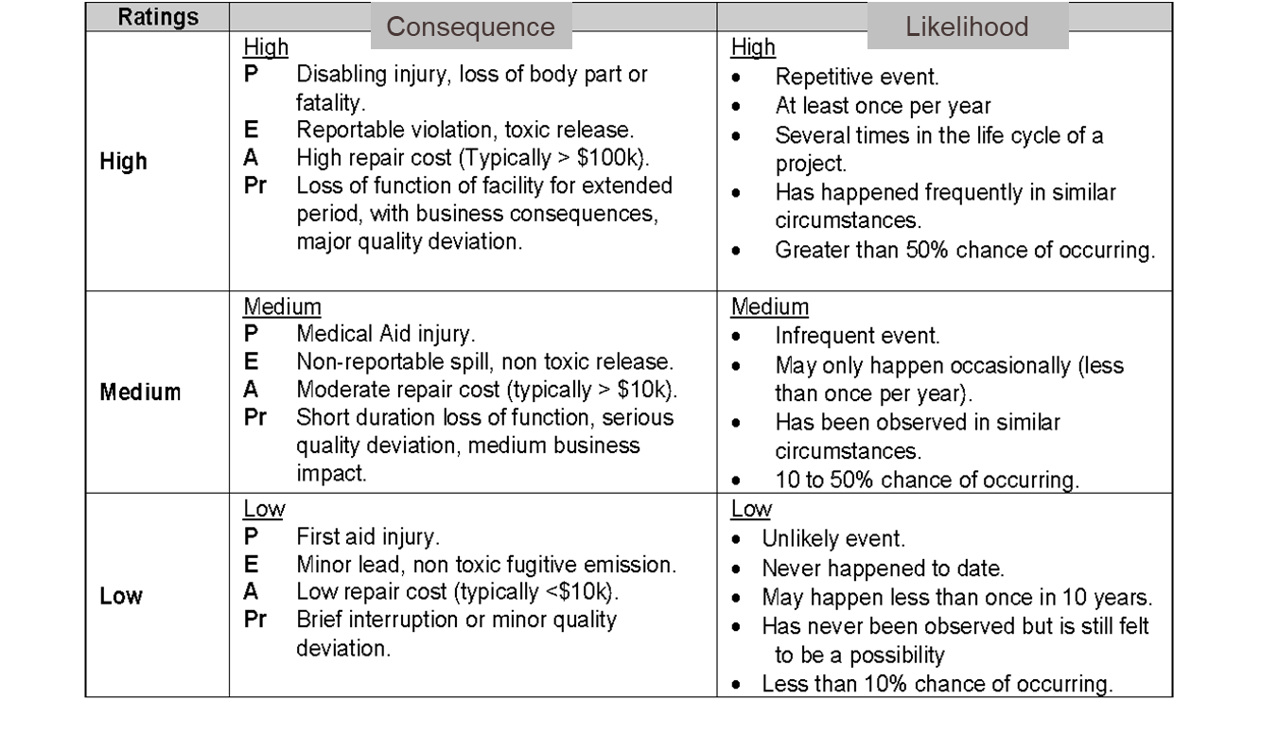
Simple Risk Matrix: relates to the Risk Criteria Table, and demonstrates the relationship that Risk is a function of Consequence x Likelihood, and categorizes the risk level.
Risk Matrix:
M
H
H
L
M
H
Increasing Consequence
L M H
L
L
M
L M H
Increasing Likelihood
Chapter 2.5 What is an Acceptable Level of Risk?
7
Notes:
7

Slide 8
What does Risk Management Direction Mean?
For any given level of risk for an activity, there must be a decision about the activity based on its risk level i.e. to proceed or not to proceed.
Risk Matrix:
M
H
H
Risk Management Directions:
High means “do not proceed”.
L
M
H
Medium means “do not proceed until further protective measures are applied”.
Increasing Consequence
L M H
Low means “proceed with caution”
L
L
M
If deemed too high, management direction will dictate how to reduce risks (likelihood and consequence) for a given activity.
L M H
Increasing Likelihood
Chapter 2.5 What is an Acceptable Level of Risk?
8
Notes:
8

Slide 9
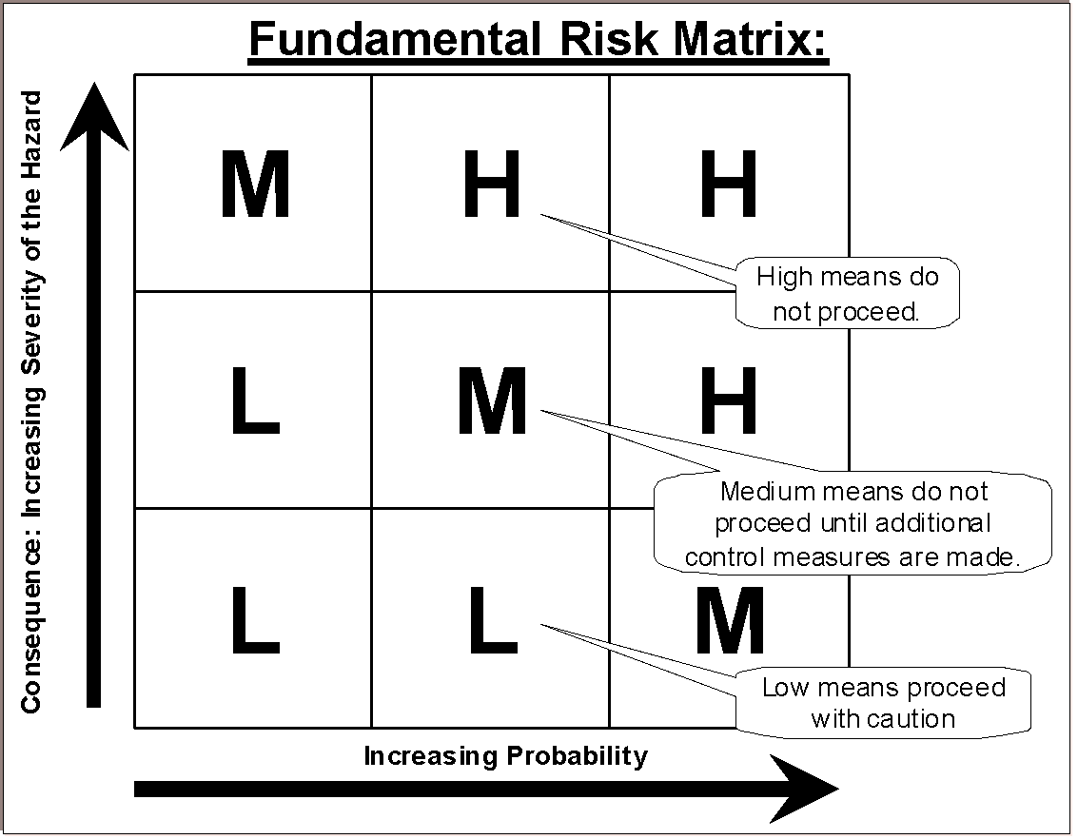
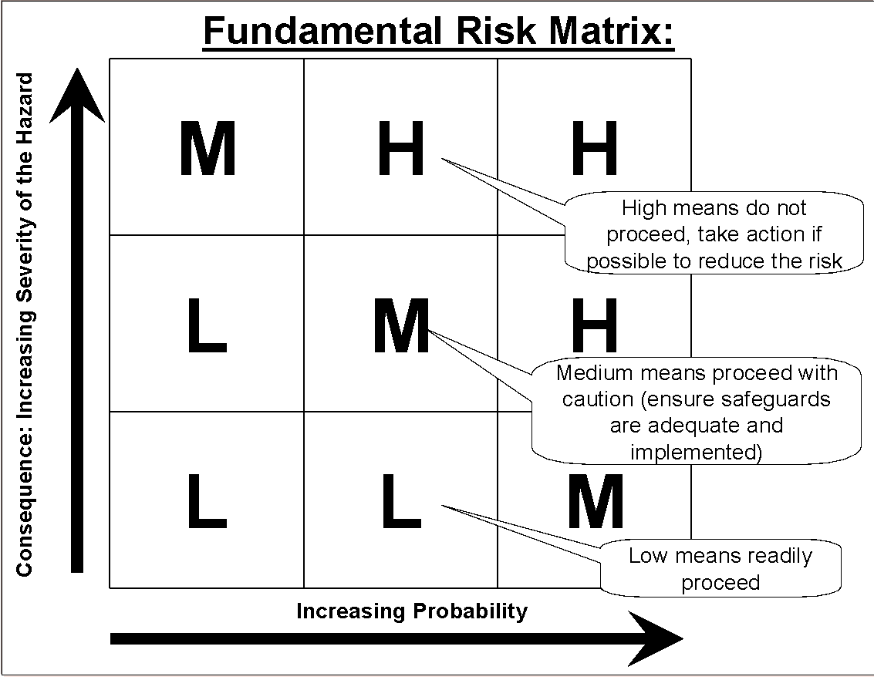
Management Direction:
Up to interpretation; depends on risk tolerance of the organization.
Every organization will have a set of Management Directions
“Company A” “Company “B”
Chapter 2.5 What is an Acceptable Level of Risk?
9
Notes:
9

Slide 10
Summary:
We evaluate risk to reduce PEAP losses and increase profitability
We use tools such as risk matrices and risk criteria tables to assess the level of risk from an activity.
If deemed too high, management direction will dictate how to reduce risks (likelihood and consequence) for a given activity to a level acceptable to the organization, or discontinue the activity if not acceptable.
The level of risk after control measures have been applied to reduce the risk to an acceptable level is termed the “residual risk”.
Chapter 2.5 What is an Acceptable Level of Risk?
10
Notes:
ENGG406 2015WENGG404 Lecture 00 - Day 1
10
10

